Slide 1
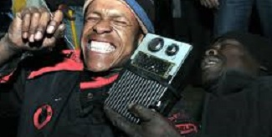
Evaluating Your Air
^{Company Name Here}
There's an old joke about listening to one station for 45 minutes without hearing the call letters,
you're listening to community radio!
Too often, this is true
It’s time to evaluate your broadcasts!
This evaluation process is a vital component to improve your station’s overall sound.
Regularly listening to yourself and your fellow DJs is essential to improving your skills as a producer.
This entire evaluation process is a bit more collaborative and participatory than sitting down in an office and being lectured.

Slide 2
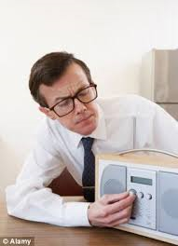
How People Use Radio
^{Company Name Here}
A listener searches for radio programming by sampling, using bits of music and other sounds to decide if a station is of interest.
Through sampling, the listener screens out most stations on the dial
When a sample is attractive, a series of other factors will determine if the listener will continue with the program
Sound - within 3-5 seconds listener identifies a rhythm, melody or voice that is inviting and interesting.
Subject - within a few more seconds, the listener identifies content that appeals to his or her tastes and interest.
Attitude - within 3-5 minutes, the listener identifies an overall feeling or mood, expressed through music and information, the style of presentation and speaking, and the approach of the host.
.

Slide 3
Everyone should listen to the aircheck for the mic/station breaks
Listen to the show in its entirety.
All participants should take and compare notes,
Take time to discuss the successes of the show, and, work together to come up with a plan to address challenges.
Formatics
Radio-specific tactics like station identification, program forward promotion, station promotion, data delivery, etc.
DJ Listening Parties for Station Success
*Plan quarterly lunch/dinner pot-lucks with your DJs
& Hosts
*Make the gathering fun and interesting with prizes/gifts
Train All DJs & Hosts to Record Their Shows
Formatics: | Yes/No | Notes
Are the mic breaks frequent enough?
Is the break too wordy or not wordy enough?
Does the break identify the show, DJ, station and the web site?
Does the break promote what’s coming up on other shows?

Slide 4
Delivery
The mechanics of speech such as tone, diction, breath control, range, pitch and pacing.
Listen for unnecessary words and sounds
like "um", "ahhh...", "duh", "okay" and other useless interjections.
These aren't just clutter the DJ/Host sounds unprepared or uninterested in the subject at hand.
Don't forget those non-verbal annoyances, too, like clicking tongues or snuffles.
DJ Listening Parties for Station Success
*It takes time, practice and awareness to become confident and credible DJs and Hosts.
* Always be aware of how you sound as you're speaking.
EVERY WORD IS IMPORTANT
comments should be concise and meaningful.
Delivery: | 1-5 | Notes
Rate the general mic break delivery, on a scale of 1 (forced, affected) to 5 (natural)
Rate the general delivery of the copy, on a scale of 1 (forced, halting, terrified) to 5 (flowing, natural, at ease)
Rate the general diction on mic, from 1 (confusing, hard to understand) to 5 (clear, crisp)
Can you hear the DJ Breathing? Are the mic and music levels consistent ? 1(loud ) to 5 even and balanced

Slide 5
- Content
Aside from how you sound, what is it you’re actually saying?
Never Read Material Cold
Rehearse every bit of copy before you read it on the air.
A show should have a flow –
play music
go live
play a spot
read a PSA
go to music
DJ Listening Parties for Station Success
* Critically listening to yourself and other on-air personalities will help you to assess your strengths and weaknesses.
A show or program will only be as good as the effort put into it
Content: | Yes/no | Notes
Are the breaks welcoming to listeners who may not know or understand the genre(s)/topic(s) presented?
Does the break give the listeners a reason to care about what is presented?
Is it evident the breaks are prepared with a limited number of elements and present a single thought or idea?
Is there radiospeak (“top of the hour”, “bottom of the hour”, “public affairs block”, etc.)?

Slide 6
Attitude
Is the on air host is calm, engaging, interesting, and in control?
Does the host sound nervous, sloppy, juvenile, or poorly prepared?
Careful on air work demonstrates care and concern for the listener, and can only have positive results for the station.
Eye Contact
Radio is an extremely intimate medium.
Radio takes place literally inside the listeners’ head.
It's very easy for the listener to have the illusion that the host is speaking personally to him, or her
Address the audience in the singular.
DJ Listening Parties for Station Success
Creating a quality program is essential to attracting and keeping listeners
It's hard to get people to tune in again after they've tuned out
An engaged listener sees the station as part of the community with shared interests, concerns, attitudes and values.
Attitude | Yes/No | Notes
Is the DJ/Host speaking only to you and not “everyone out there in radio land”?
Does the DJ/Host regularly use “you” to accentuate the listener “eye contact” (for example, “you just heard” not “I just played”)?
Does the DJ/Host sound relaxed, confident, competent and engaging?
Does the DJ/Host “break the mood” by discussing technical issues?

Slide 7
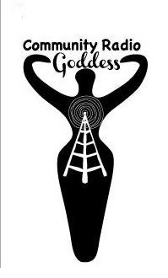
Station Listening Parties can be a great social gathering for all
Try to pare down to an absolutely concise and genuine sound, as if you were speaking to a friend (which, in fact, you are - that's how you want to be perceived by the listener)..
DJ Listening Parties for Station Success
*Plan quarterly Listening Parties
By gathering and sharing, you will improve your sound

